Slide 1
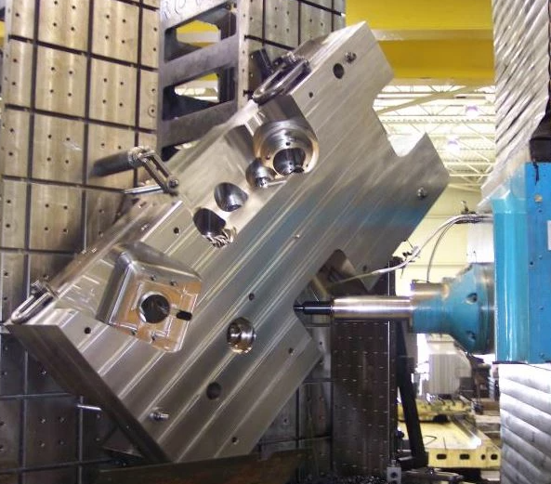
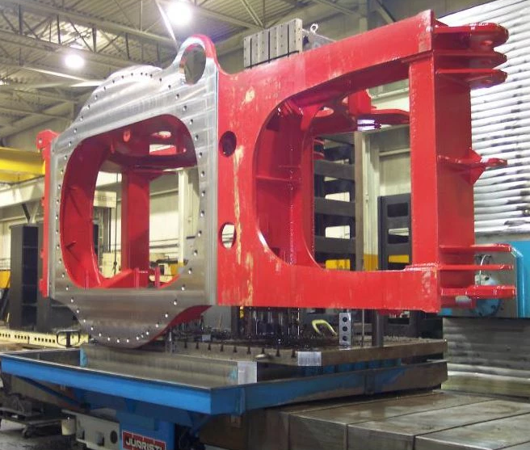
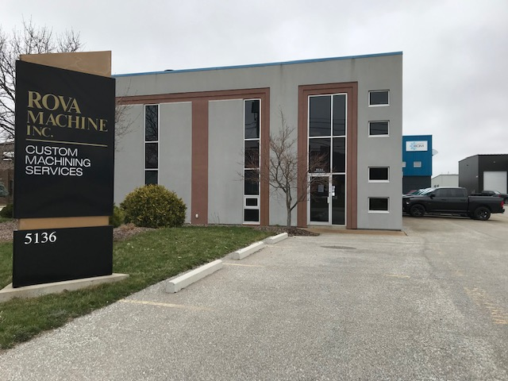
MACHINING
CAPABILITIES

Slide 2
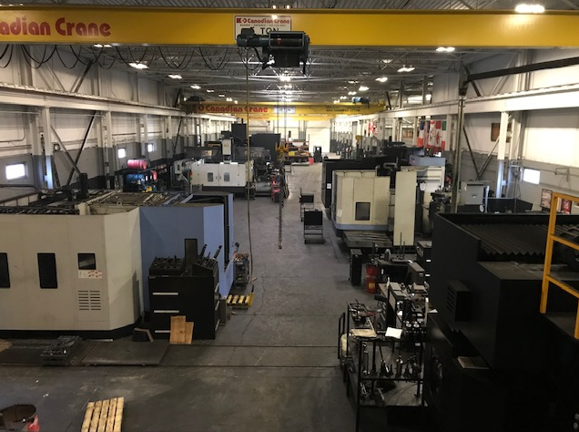
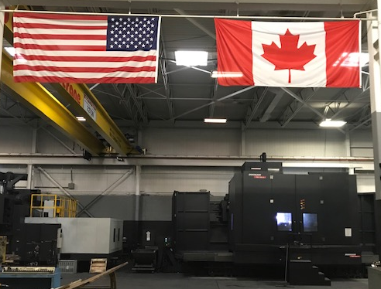
Contents
1.) Horizontal Equipment
2.) Vertical Equipment
3.) Jig Bore Equipment
4.) 5-Axis Equipment
5.) Grinding Equipment
6.) Turning Equipment
7.) Lifting Equipment

Slide 3
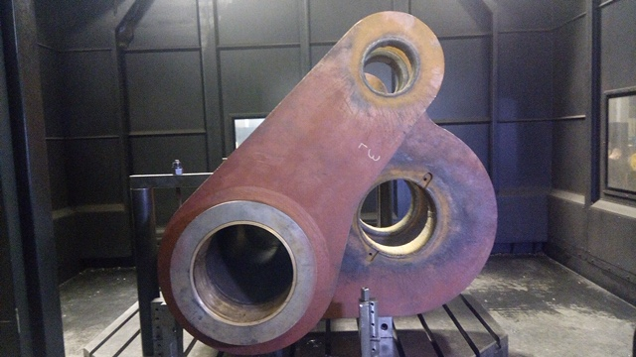
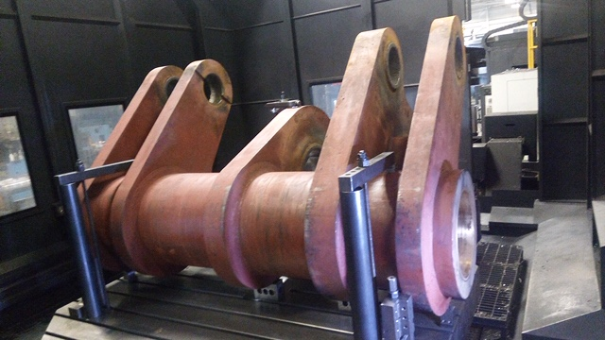
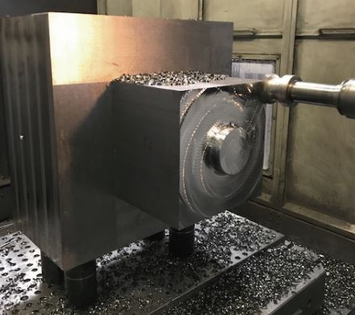
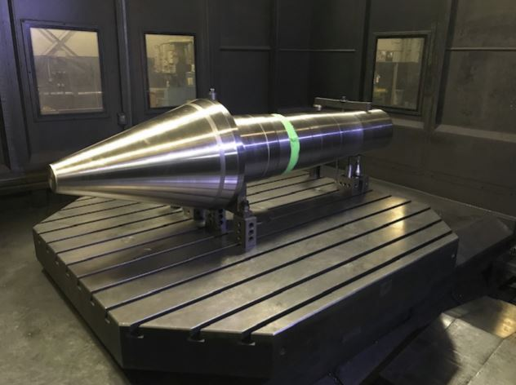
Horizontal equipment
MAKINO A71 (TABLEWT: 2,000 LBS)(DOUBLE-PALLET/ROTARY TABLE)
X - 29" Y - 29" Z - 32"
DOOSAN 6300 (TABLEWT: 5,500 LBS) (DOUBLE-PALLET/ROTARY TABLE)
X - 41" Y - 33" Z - 39"
DOOSAN 110S (TABLEWT: 15,500 LBS) (ROTARY TABLE)
X - 80" Y - 60" Z - 47"
DOOSAN 130S (TABLEWT: 22,000 LBS) (ROTARY TABLE)
X - 80" Y - 60" Z - 47"
DOOSAN 130L (TABLEWT: 33,000 LBS) (ROTARY TABLE)
X - 160" Y - 100" Z - 80"

Slide 4
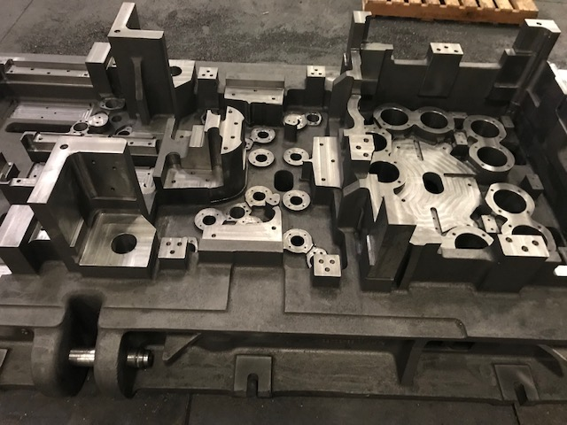
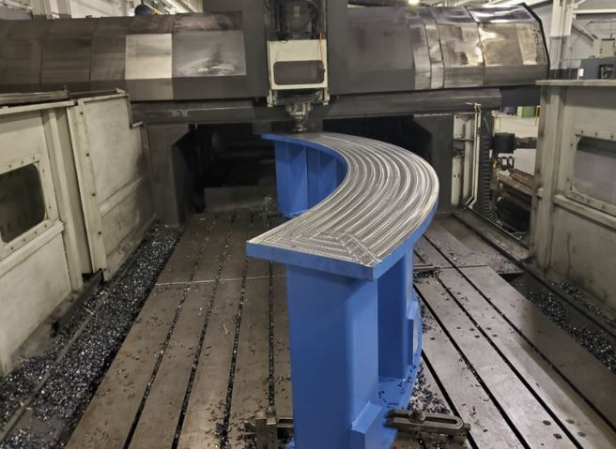
VERTICAL EQUIPMENT
AGMA BDN 4228 (TABLEWT: 26,000 LBS)
X - 165" Y - 104" Z - 40" ​

Slide 5
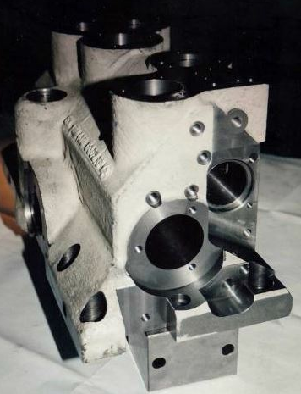
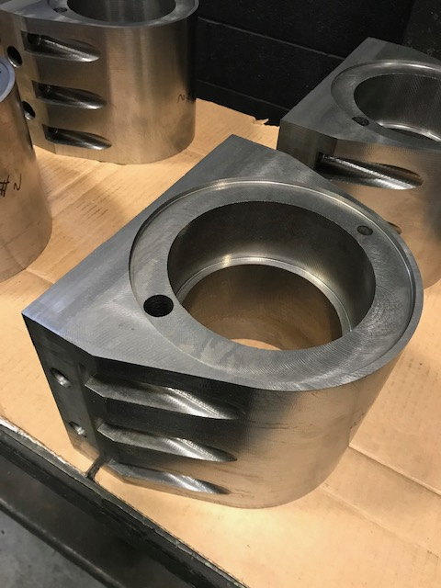
Jig bore equipment
740 SIP JIG BORE
X - 40" Y - 60" Z - 35"
7A SIP HIGH COLUMN
X - 40" Y - 60" Z - 70"

Slide 6
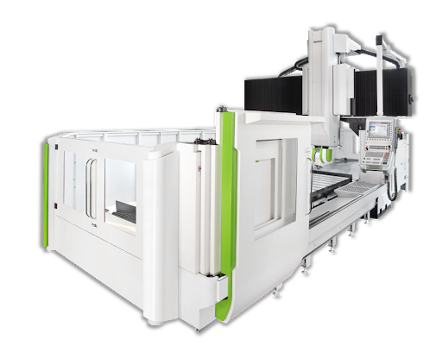
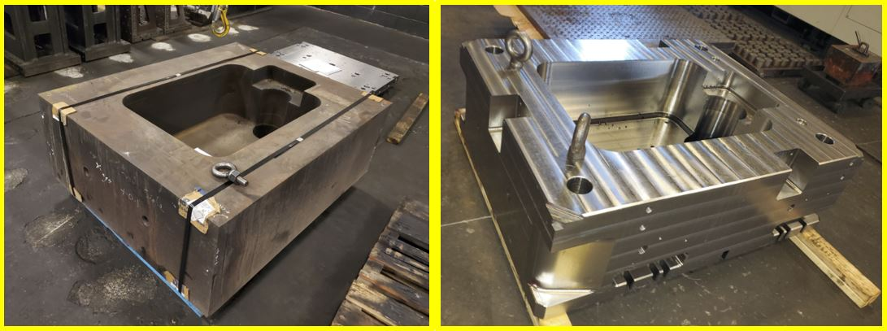
5 axis equipment
HARTFORD 320 (TABLEWT: 22,000 LBS)
X - 118" Y - 80" Z - 40"

Slide 7
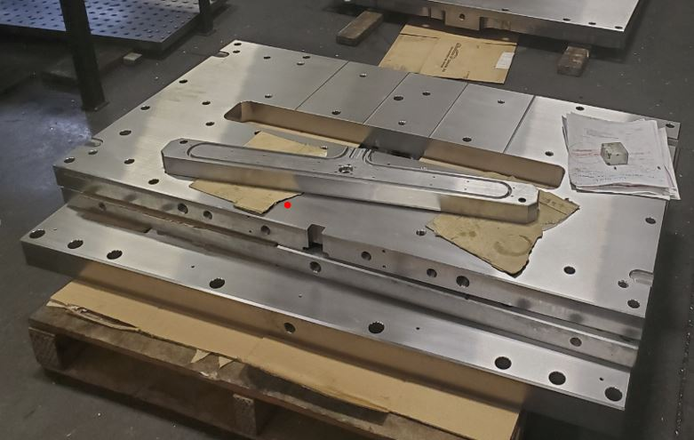
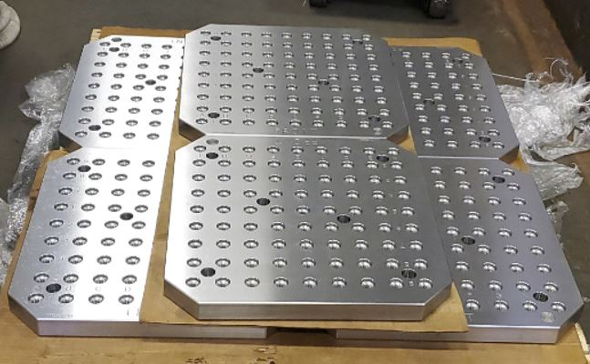
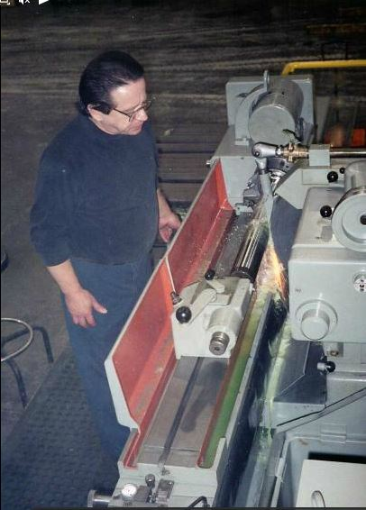
Grinding equipment
THOMPSON SURFACE GRINDER (TABLEWT: 3,500 LBS)
X - 120" Y - 36" Z - 36"
KELLENBERGER OD/ID GRINDER
CHUCK DIAMETER - 6"
X - 60" Z - 12" ​

Slide 8
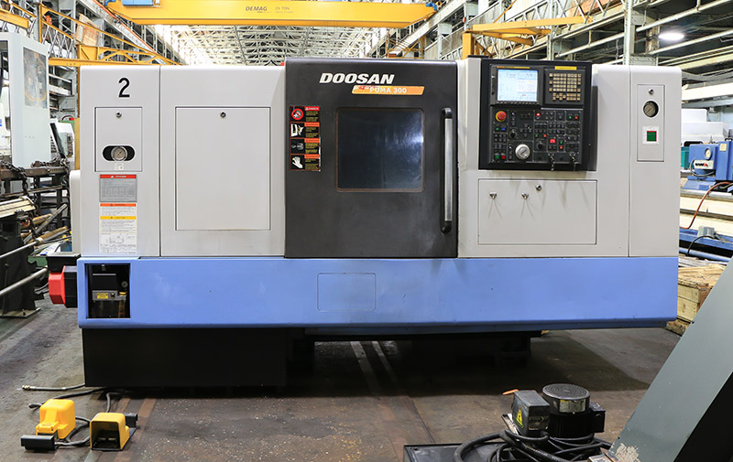
Turning equipment
DOOSAN PUMA 300 W/ TURRET CHANGER
CHUCK DIAMETER - 12"
X - 11" Z - 26.8" ​

Slide 9
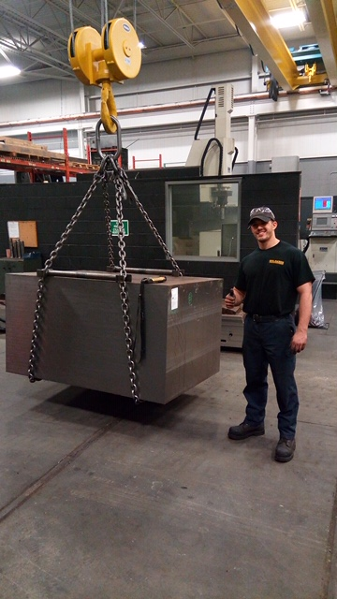
LIFTING EQUIPMENT
CANADIAN CRANE - 22 TON (44,000 LBS)
MAIN HEAD: 22 TON
AUX HEAD: 12.5 TON
CANADIAN CRANE - 20 TON (40,000 LBS)
MAIN HEAD: 20 TON
AUX HEAD: 14 TON
CANADIAN CRANE - 5 TON (10,000 LBS)
MAIN HEAD: 5 TON
KONE CRANE - 5 TON (10,000 LBS)
MAIN HEAD: 5 TON
KONE CRANE - 5 TON (10,000 LBS)
MAIN HEAD: 5 TON
FORKLIFT - 4 TON (8,000 LBS)

